Slide 1


-Butterfly Classification using Transfer Learning-
Batch No: 1
Bharathwaj M (RA2011026020065)
Harshit V (RA2011026020086)

Slide 2
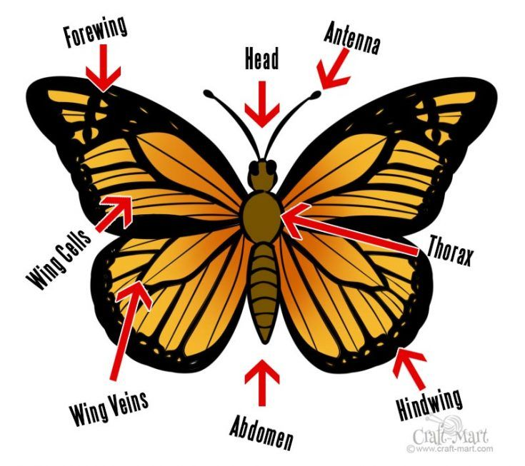
- Introduction-
The patterns of butterﬂies are essential features for researchers and people who are interested in categorizing butterﬂies.
However, it is difficult to classify butterﬂies based on biological patterns, such as
Shapes,
Wing colors and
Veins
Currently, researchers rely mostly on time-consuming processes dealing with manually identifying and classifying by highly trained individuals.
Therefore, to tackle, there is a need for modern and automated technologies in dealing with species identiﬁcation with good accuracy.

Slide 3
- System Requirement-
Hardware Requirements
Computer with sufficient processing power and memory.
Optional: GPU for faster training.
Software Requirements
Python 3.6 or later.
OpenAI deep learning framework.
Pre-trained ResNet-50 model.
Data preprocessing libraries: NumPy, Pandas, OpenCV.
Additional libraries as needed: Matplotlib, sci-kit-learn.

Slide 4
-Literature Survey-
SL.NO | JOURNAL NAME | YEAR OF PUBLISH | PAPER TITLE | AUTHOR | DESCRIPTION
1 | IEEE | 2020 | Butterfly Image Classification Using Convolutional Neural Network (CNN) | Nur Nabila, Nurbaity Sabri, Nur Farahin | This research paper presents a study on butterfly species identification using image processing techniques and Convolutional Neural Networks (CNN). The aim of the study is to classify images of butterflies using CNN techniques and evaluate the performance of the classification.

Slide 5
-Literature Survey-
SL.NO | JOURNAL NAME | YEAR OF PUBLISH | PAPER TITLE | AUTHOR | DESCRIPTION
2 | IEEE | 2020 | Using Partial Least Squares in Butterfly Species Identification | Alexandre Silva, Sincler Meireles, Samira Silva | This research paper proposes a novel approach to recognizing butterfly species in images using handcrafted descriptors and the Partial Least Squares (PLS) algorithm. The approach involves extracting features from a butterfly dataset using Local Binary Patterns (LBP) and Histogram of Oriented Gradients (HOG) descriptors, training PLS models using a one-against-all protocol, and presenting images to all classifiers during the test phase.

Slide 6
-Literature Survey-
SL.NO | JOURNAL NAME | YEAR OF PUBLISH | PAPER TITLE | AUTHOR | DESCRIPTION
3 | IJCONSIST | 2021 | Classification of color features in butterflies using the Support Vector Machine (SVM) | Dhian Satria, Hendra Maulana | The paper discusses the use of butterflies as a dataset for research in digital images and focuses on the extraction process of color features using the RGB method and the Hue, Saturation, Value (HSV) color space. The proposed classification process uses a Support Vector Machine (SVM) to classify butterfly species.

Slide 7
-Literature Survey-
SL.NO | JOURNAL NAME | YEAR OF PUBLISH | PAPER TITLE | AUTHOR | DESCRIPTION
4 | MDPI | 2022 | Classification of color features in butterflies using the Support Vector Machine (SVM) | FathimatuR ajeena, Rasha Orban, Malliga | This research work aims to assist science students in correctly recognizing butterflies without harming the insects during their analysis. This paper discusses transfer learning-based neural network models to identify butterfly species.

Slide 8
- Abstract -
Classification of butterfly species from images is a challenging task due to the high variability in their appearance and the large number of species.
This task has important applications in various fields such as conservation biology and wildlife monitoring.
Our objective is to develop an application can detect the category of a butterﬂy by using deep learning techniques.
We will be using transfer learning, which is a popular convolutional neural network (CNN) technique used to image classification.

Slide 9
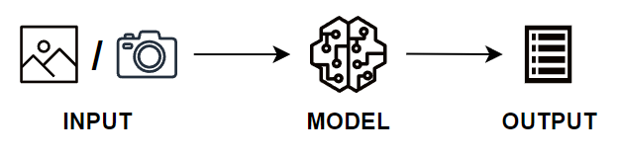
- Objective -
The objective is to develop an application can detect the category of a butterﬂy by either capturing a real-time picture of a butterﬂy or choosing one picture from gallery.
Finally this will be made as an Web App with clean UI/ UX and additionally Open AI’s GPT will be implemented for getting the information about the predicted butterfly species.

Slide 10
- Scope -
The Scope of the project is to develop a deep learning-based model for classifying images of different butterfly species using transfer learning with ResNet50.
Collect and prepare a dataset of images of butterfly species, including image acquisition and labeling.
Implement image pre-processing techniques, such as resizing, normalization, and augmentation, to improve the performance of the classification model.
Investigate the use of different hyperparameters, model architectures to optimize the performance of the classification model and compare the performance of the deep learning model with standard machine learning models.

Slide 11
- Existing System -
CNN WITH 4 CONVOLUTIONAL LAYER
85% Accuracy
100 Epochs
PARTIAL LEAST SQUARES (PLS)
76% Accuracy
SUPPORT VECTOR MACHINE (SVM)
75% Accuracy
At 768x576 Pixel
CNN WITH VGG19
92% Accuracy
45 Epochs

Slide 12
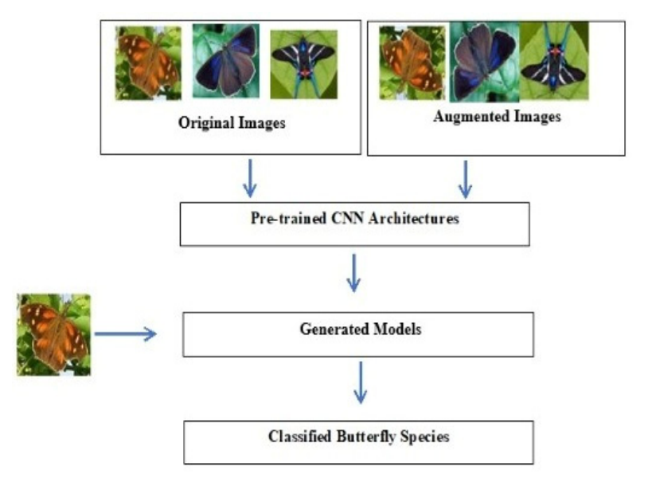
- Proposed System -
In our system we will be using CNN with ResNet 50.
ResNet 50 is a pretrained convolutional neural network model that is 50 layers deep.
We will be training the CNN with the help of transfer learning technique by using the weights of the ResNet 50 model.
We were able to achieve accuracy of 96% and it is expected to be 98% with further fine tuning.
Finally this will be made as an Web App with clean UI/ UX and additionally Open AI’s GPT will be implemented for getting the information about the predicted butterfly species.

Slide 13
- Methodology -
Convolutional Neural Network (CNN):
CNN is a type of artificial neural network commonly used in deep learning and computer vision applications.
CNNs are particularly well-suited for image and video recognition tasks because they can automatically identify and learn features in images, such as edges, shapes, textures, and patterns, without requiring manual feature extraction.
Each layer in a CNN consists of many small filters, also known as kernels or feature detectors, that slide over the input image and detects the features and saves it in a feature map.

Slide 14
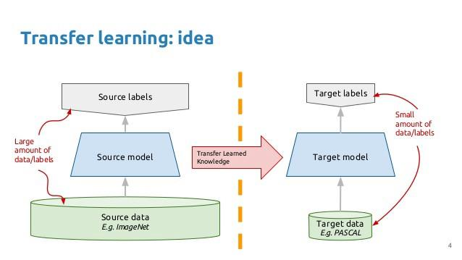
- Transfer Learning -
Transfer Learning with CNN:
Transfer learning taking a model trained on a large dataset and transfer its knowledge to a smaller dataset.
Since this project is based on Image Classification we will be using
ResNet50 (Pre-trained model) with the
Weights of ImageNet (A very large collection of Image dataset)
Using this our CNN will be trained to achieve greater accuracy than the existing models.

Slide 15
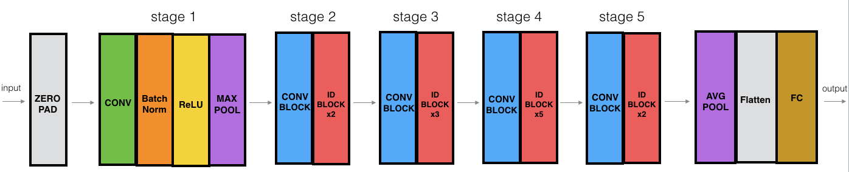
- ResNet-50 – Architecture -
1 MAX POOL LAYER
48 CONVOLUTION LAYERS
1 AVERAGE POOL LAYER

Slide 16
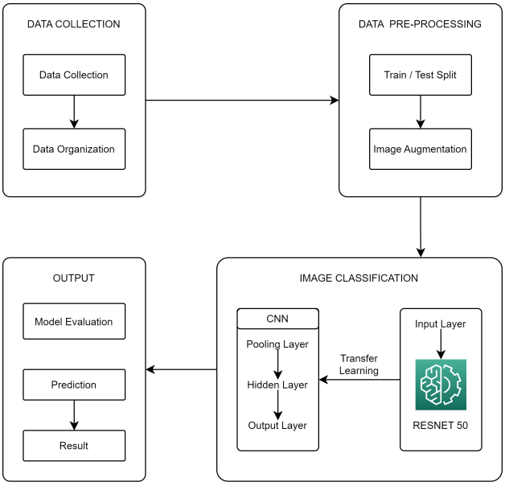
- System Architecture -

Slide 17
- Modules -
1
IMPORTING & PRE-PROCESSING DATA
2
BUILDING & TRAINING CNN WITH RESNET-50
3
EVALUATING THE ACCURACY AND LOSS
4
PREDICTING
THE TEST
IMAGES

Slide 18
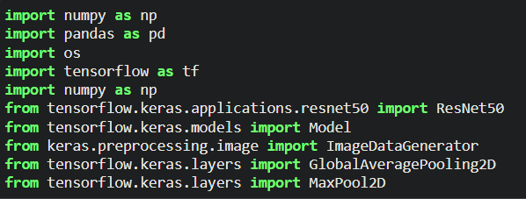
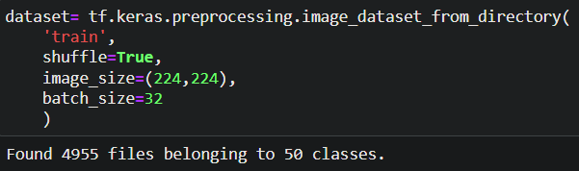
- Implementation -
1. IMPORTING & PRE-PROCESSING DATA

Slide 19
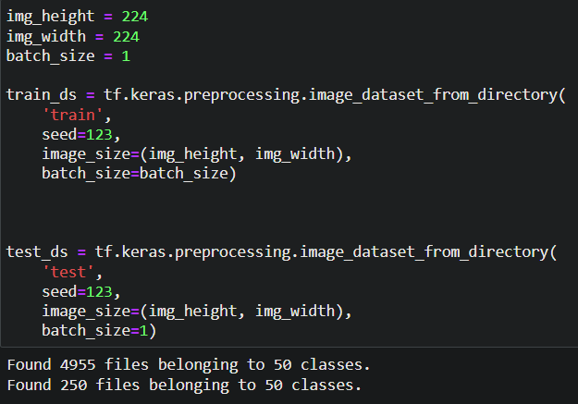

Slide 20
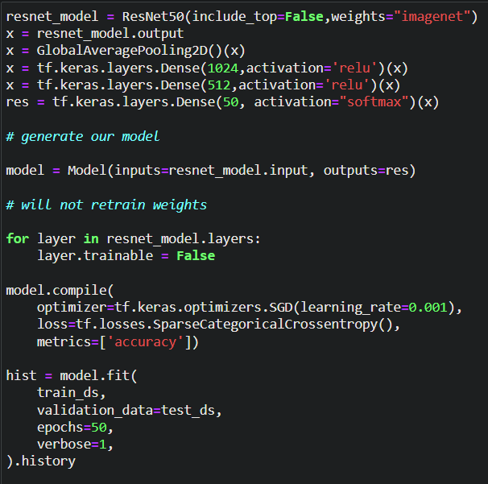
2. BUILDING & TRAINING CNN WITH RESNET-50

Slide 21
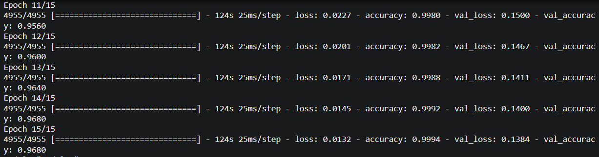
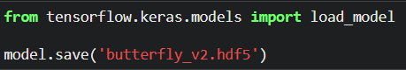
SAVING THE MODEL

Slide 22
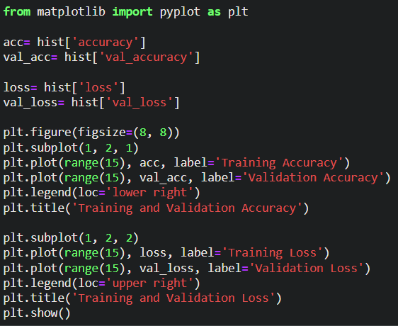
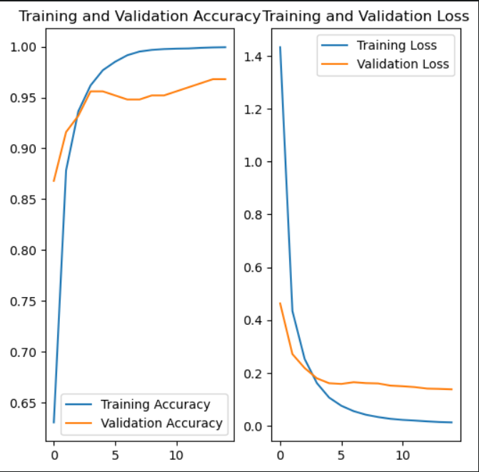
3. EVALUATING THE ACCURACY AND LOSS

Slide 23
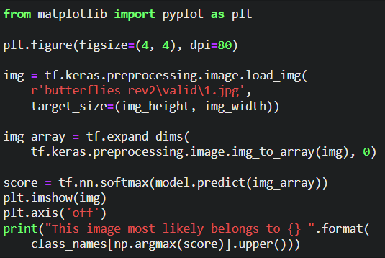
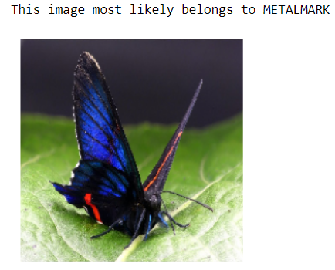
4. PREDICTING THE TEST IMAGES

Slide 24
- References -
Butterfly Image Classification Using Convolutional Neural Network (CNN)
IEEE | 2019 | DOI: 10.1109/I2CACIS.2019.8825031
Using Partial Least Squares in Butterfly Species Identification
IEEE | 2020 | DOI: 10.1109/SIBGRAPI51738.2020.00047
Classification of color features in butterflies using the Support Vector Machine (SVM)
IJCONSIST | 2021 | DOI: doi.org/10.33005/ijconsist.v2i02.50
A Novel Method for the Classification of Butterfly Species Using Pre-Trained CNN Models
MDPI | 2022 | DOI: doi.org/10.3390/electronics11132016

